Slide 1
Race & the Criminal Justice System
Fall 2020 Professor Gaston
Agenda
Week 10
November 3, 2020
Review course schedule
Upcoming documentary
Lecture

Slide 2
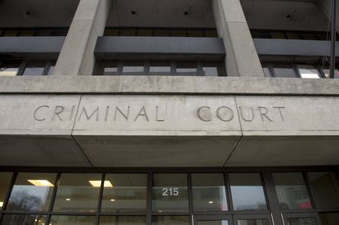
Race/Ethnicity and Court Processing
Tuesday November 3, 2020

Slide 3
Overview
Court processing is interdependent
Nature of the criminal court system
Race/ethnicity and class
This week’s focus

Slide 4
Race/Ethnicity & Counsel
Legalities of legal counsel
Public defender vs. private attorney
Race/ethnicity and class

Slide 5
Pretrial status
Presumption of innocence
Pretrial release vs. pretrial detention
Bail
Race/ethnicity and class

Slide 6
Pretrial detention
Jail incarceration
Disadvantages of pretrial detention
Race/ethnicity and class

Slide 7
Race/Ethnicity & Prosecutorial Decisions
Prosecutor’s role
Charging decisions
Plea bargaining
Race/ethnicity and class

Slide 8
Race/Ethnicity & Plea Bargaining
Prevalence
How it works
Advantages
Problems and criticisms
Race/ethnicity and class

Slide 9

Time: The Kalief Browder story

Slide 10
Questions???
Notes:
Post your questions to the Week 10 Questions Discussion Forum on iCollege

